Slide 1
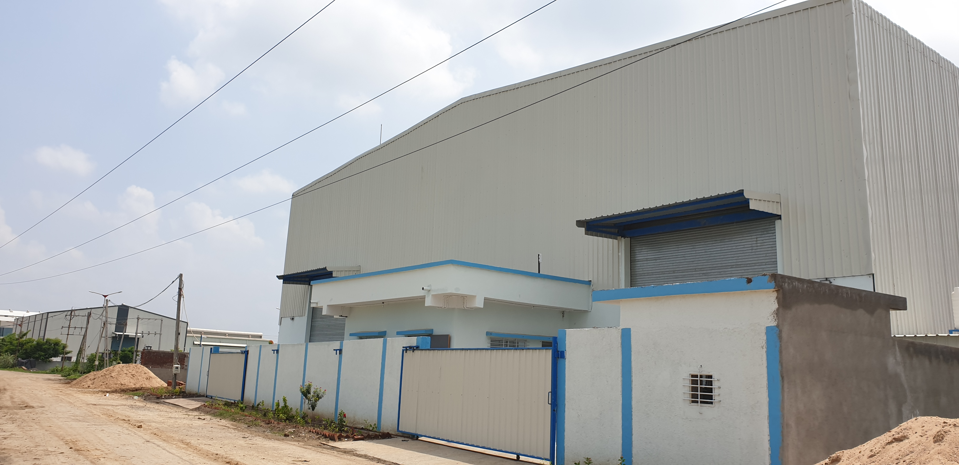
Sudhan Industries

Slide 2
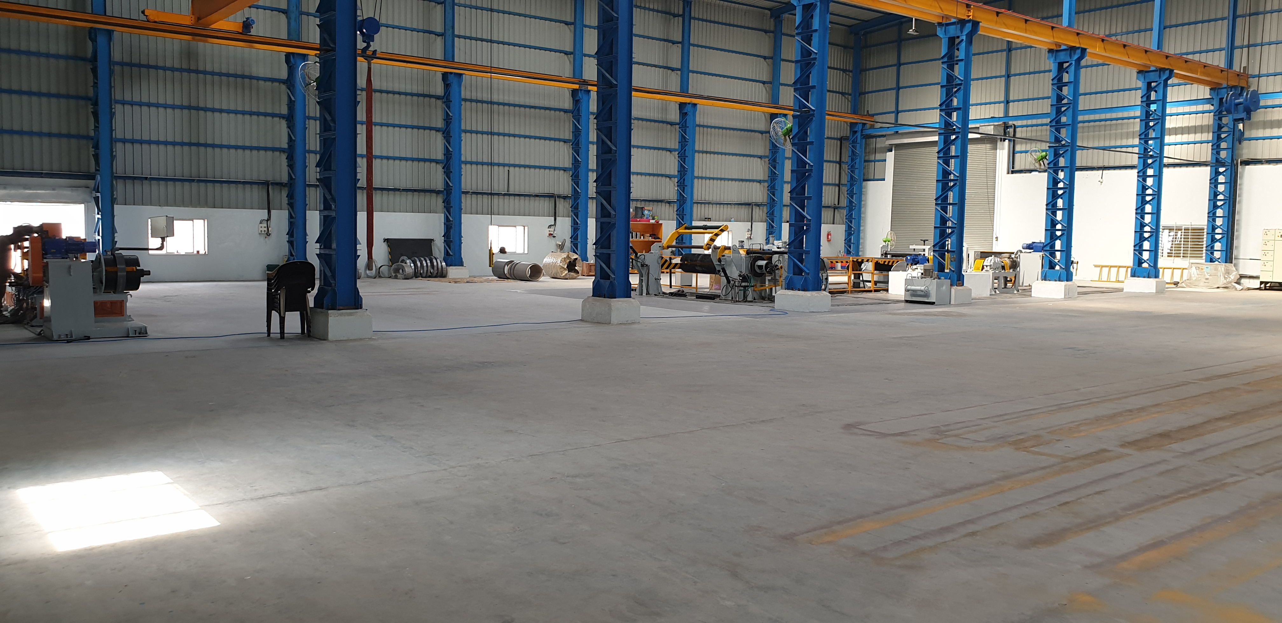
About Us
Sudhan Industry Is Leading Transformer Core Manufacturing Company.
With our newly established and equipped with all advance machinery, modern production facility and service support of industrial professional Sudhan Industries is engaged in manufacturing of high quality and performance-oriented power and distribution transformer laminations.

Slide 3
Quality and Management Policy

Slide 4
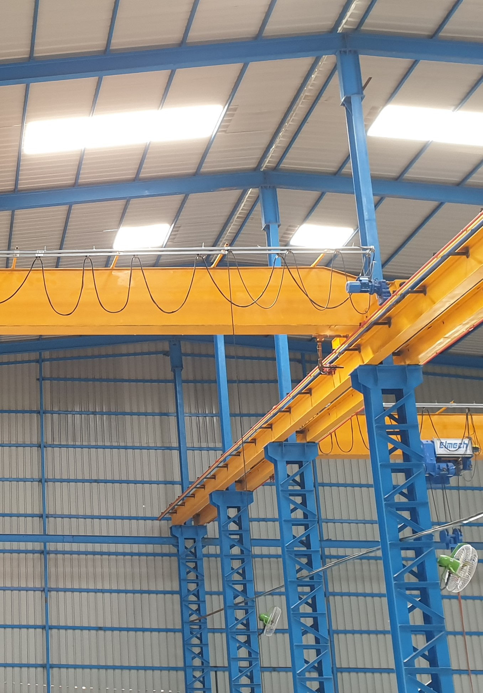
Quality & Management Policy
QMS is a set of policies, processes and procedures required for planning and execution (production/development/service) in the core business area of an organization.
Our company Sudhan Industries integrates the various internal processes within the organization and intends to provide a process approach.
A process based QMS enables the organizations to identify, measure, control and improve the various core business processes that will ultimately lead to improved business performance.

Slide 5
From Director ‘s Desk

Slide 6

From Director’s Desk
We at Sudhan Industries are committed to follow the quality management system laid down to ensure cost effective quality of our products.
Quality of our product and the production process is our prime concern.
By adopting a process approach and a continual improvement policy, we will achieve consistent product quality, thereby leading to Total Customer Satisfaction.

Slide 7
Products

Slide 8
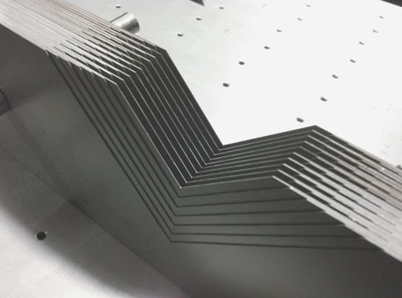
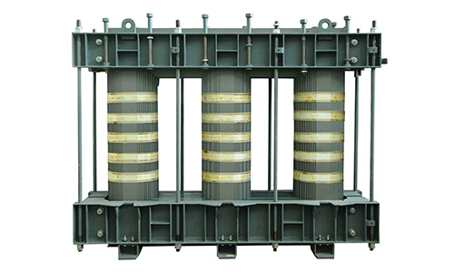
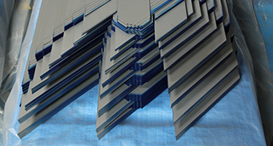
Products
Step Lap Lamination Type
CRGO Transformer Lamination Core
CRGO Stacked Assembly Core
Vertical Step Lap Lamination Core
Horizontal Step Lap Lamination Core

Slide 9
Services

Slide 10
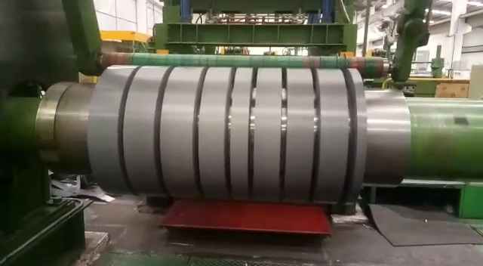
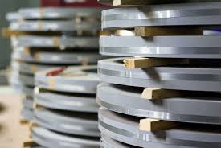
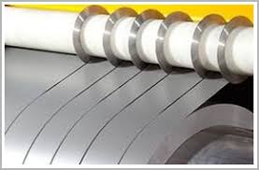
Services
We have wide range of Slitting facility in CRGO, CRNGO and other Metals CRC, with Fully automatic CNC Slitting Line with high quality precise slitting cutter to maintain Burr Level. Our Slitting range is of Width 10mm to 1250mm. Slitting capacity in thickness 0.10mm to 1mm Thickness.

Slide 11
Mission

Slide 12
Mission
Our mission is to produce and continually develop quality products at a competitive price. We will always strive to service our customer with the utmost integrity, and to their complete satisfaction. It is our goal to ensure our mission by continuous self improvement, growth in our operations and employees; while maintaining profitability to the benefit of our customers, employees, and community.

Slide 13
Vision

Slide 14
Vision
We dedicate ourselves to be the supplier of choice when our type of products are being sought. This vision will be accomplished by sharing the responsibilities of planning and decision making with all of our employees.

Slide 15
Our Values

Slide 16
Our Values
Integrity
For us, Integrity implies honesty and transparency in our business processes and the highest level of ethical behaviour and professional act in customer services.
Customer First
Customer demands for our products and their feedbacks are driving force for our growth and development. We create long term relationship with customers through value addition in their products and processes. At Finar, employees treat customers with honesty, respect and dignity.
Commitment
At Finar, we are committed to all our stakeholders adopting best practices in business operations to honour our deliverables to every person, entity or organization, associated with us.

Slide 17
Our Values
Respect for Individual
We are committed to create a work culture that encourage trust in the organisation, respect to an individual and value the diversity in the organisation.
Contribute to the Society
We believe that our responsibility as a member of society to create value in society through improvement in health care, education and caring for environment.

Slide 18
Infrastructure

Slide 19
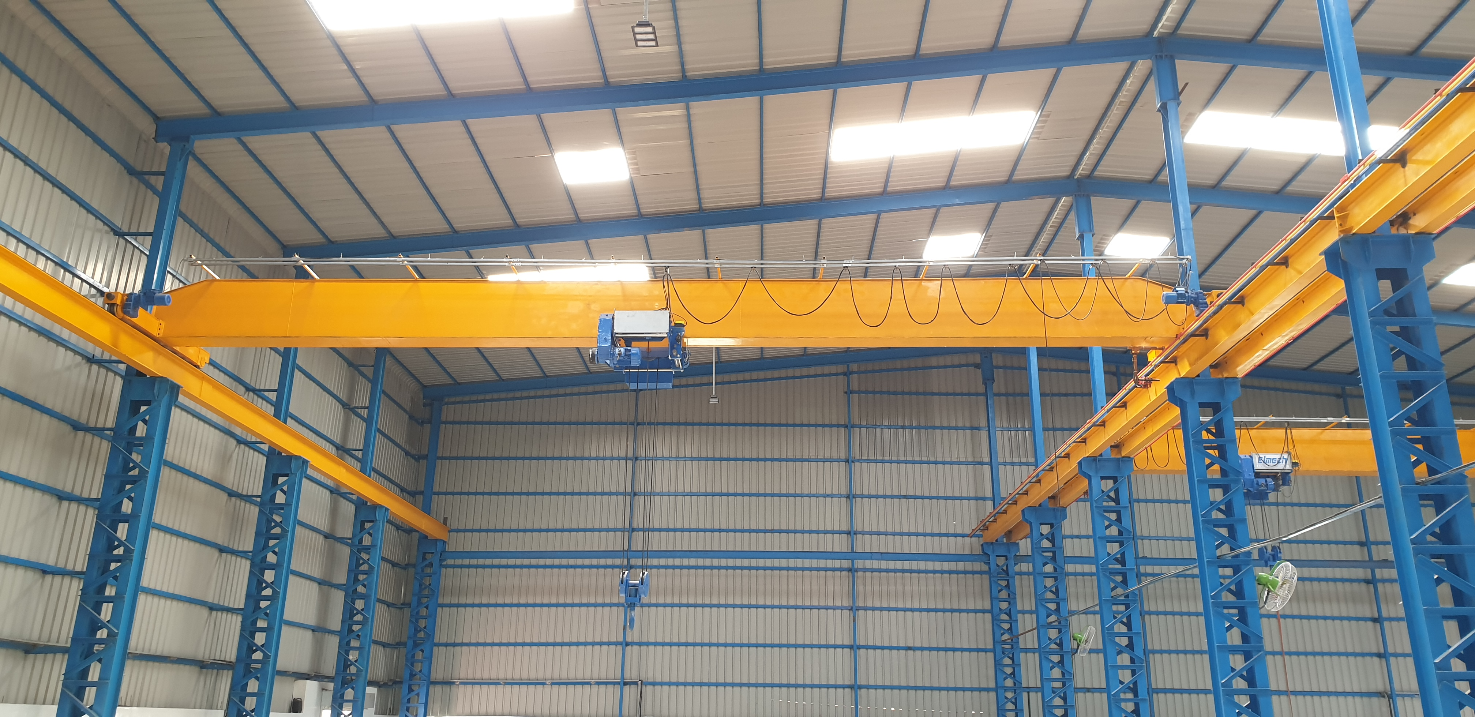
Infrastructure
1250 CNC Slitting line china make.
400mm CNC Cut To Length line china make.
Measuring instruments with standard tool room and testing equipment's for quality assurance.
2 10MT EOT cranes

Slide 20
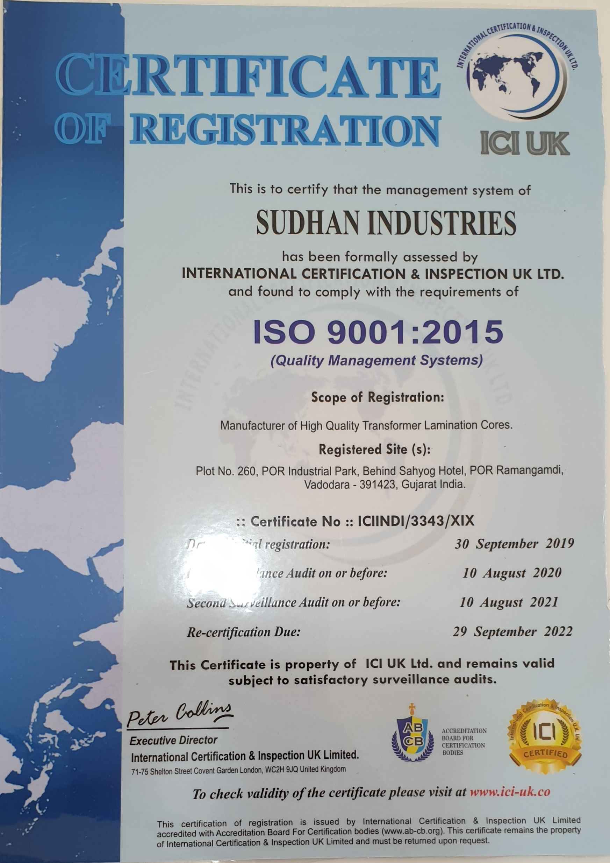
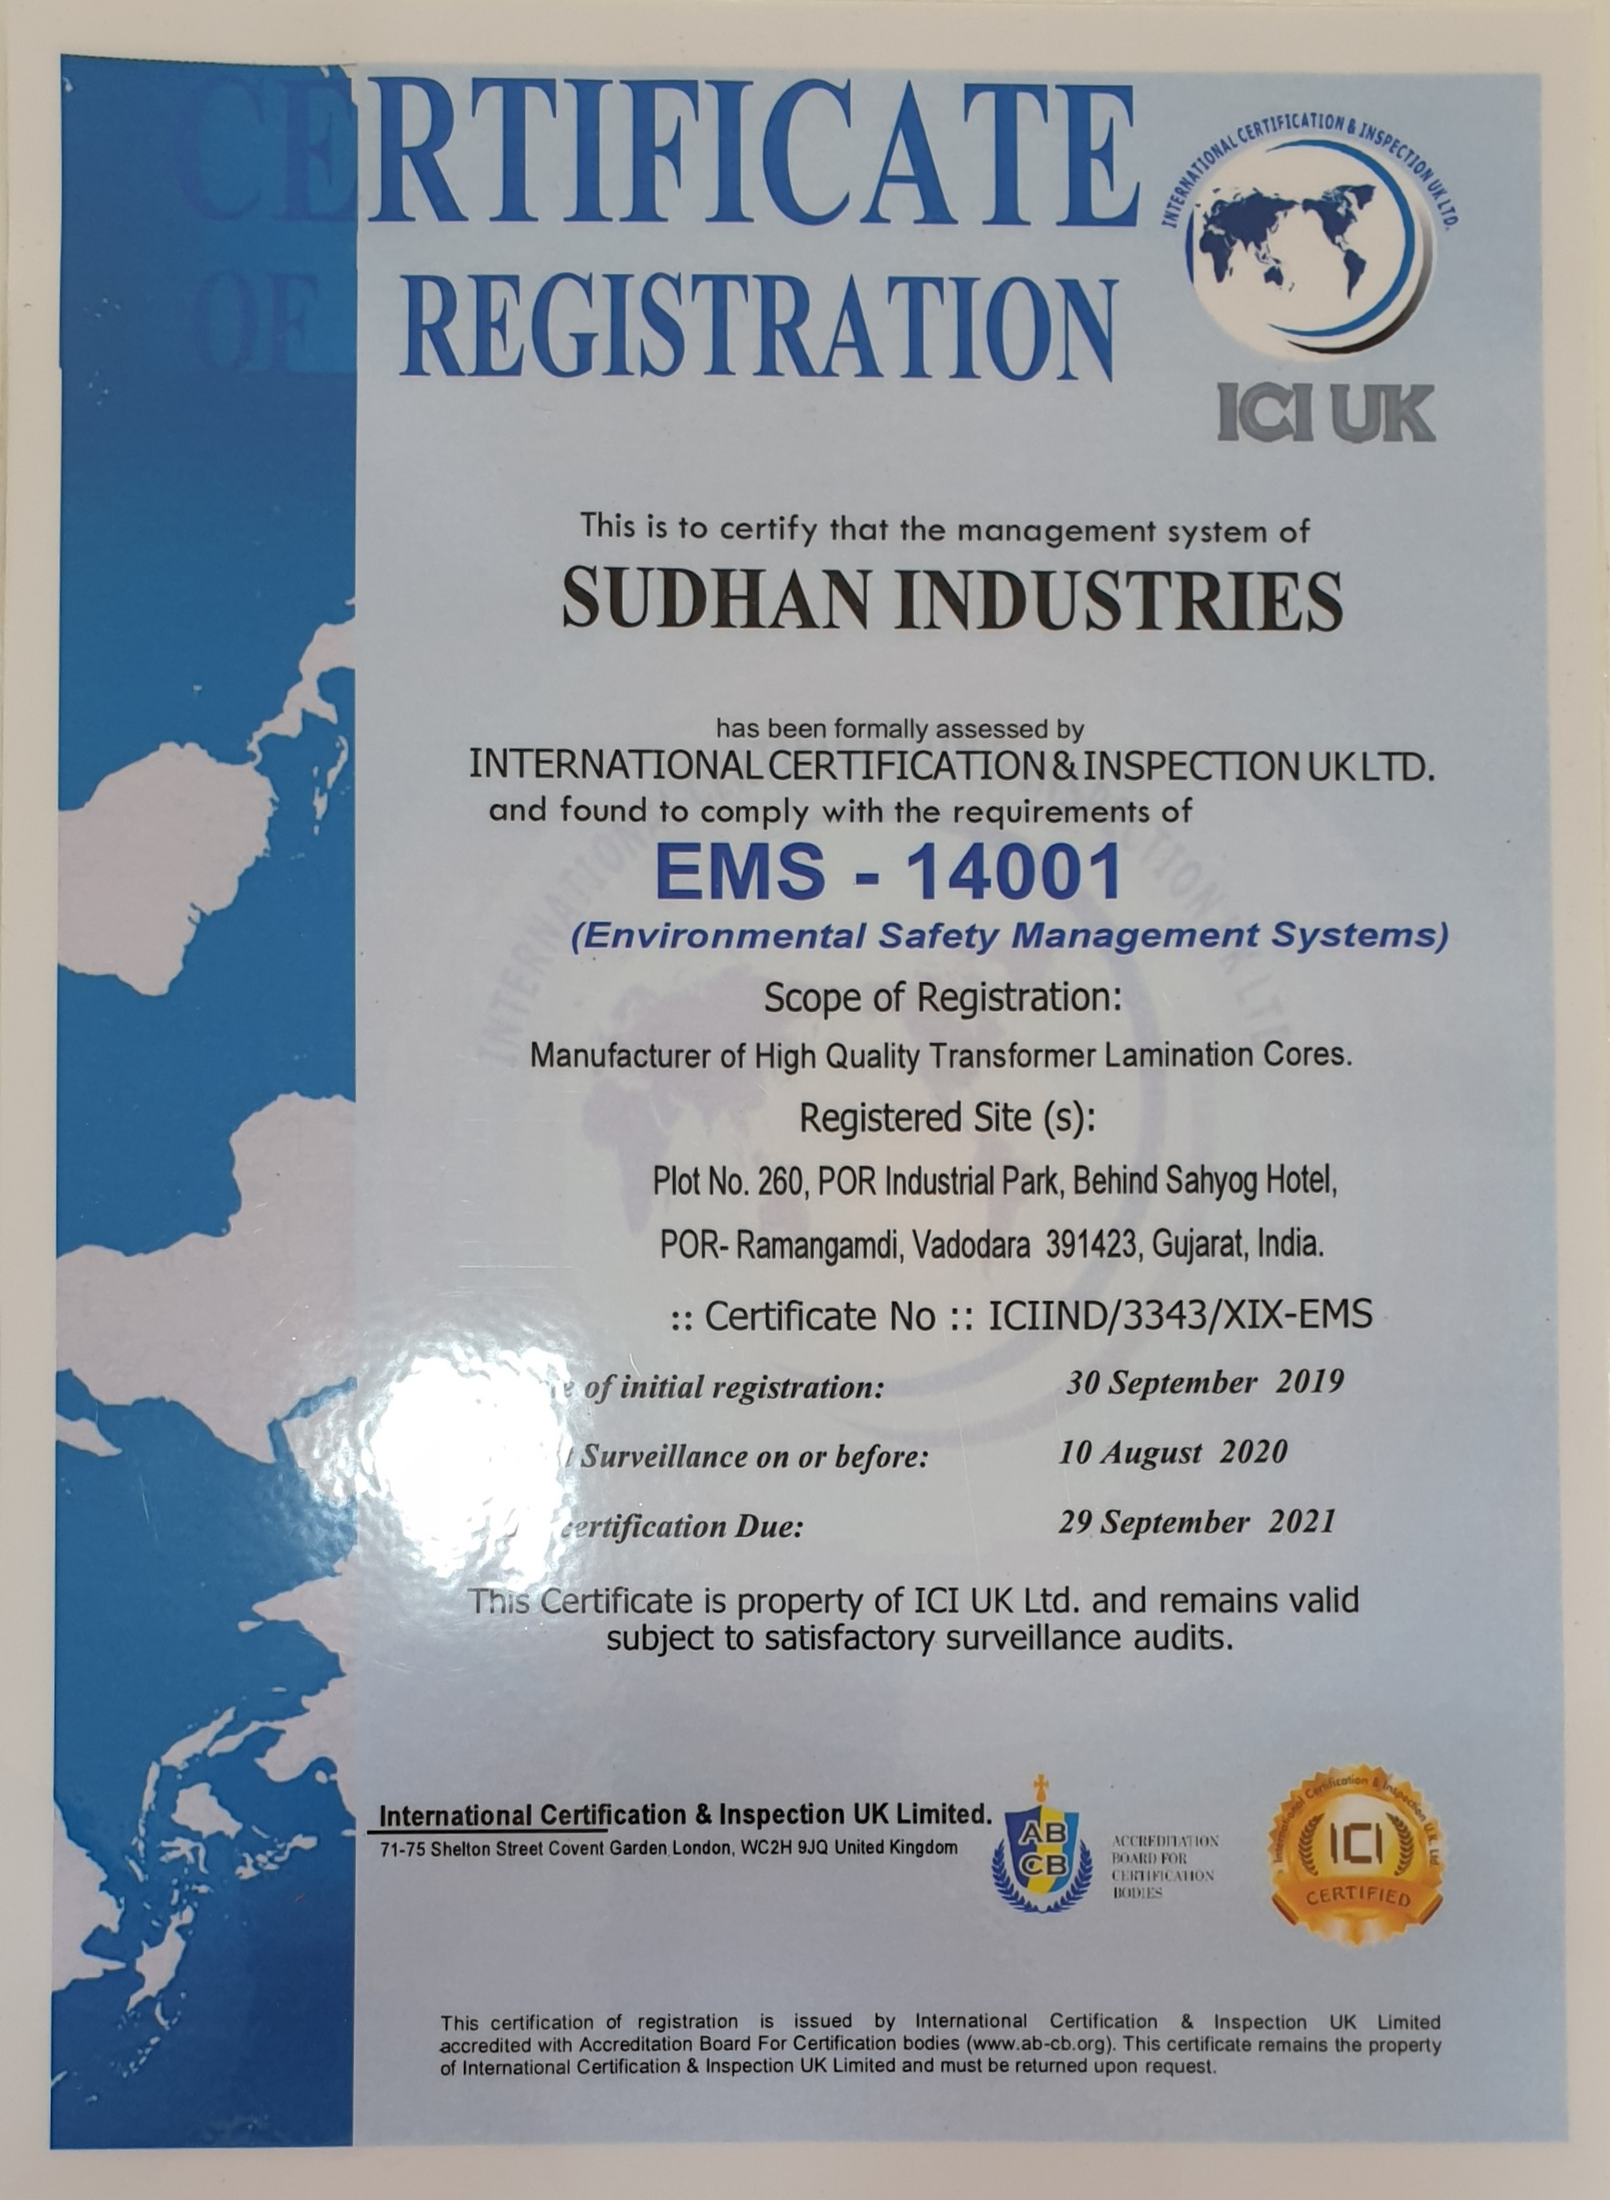
ISO Certification

Slide 21
Thank You

